Slide 1
Digital Portfolio
STUDENT NAME: AMJED AHMED
REGISTER NO AND NMID: 36624U18005
DEPARTMENT: BSC COMPUTER SCIENCE
COLLEGE: COLLEGE/ UNIVERSITY MERIT HAJI ISMAIL SAHIB ARTS & SCIENCE COLLEGE

Slide 2
PROJECT TITLE Naan Mudhalvan PROJECT

Slide 3


AGENDA
Problem Statement
Project Overview
End Users
Tools and Technologies
Portfolio design and Layout
Features and Functionality
Results and Screenshots
Conclusion
Github Link
3/21/2024 Annual Review

Slide 4

PROBLEM STATEMENT
In today’s competitive digital world, students and professionals in the field of Computer Science often face challenges in showcasing their skills, academic background, and projects to potential recruiters, collaborators, and peers. Traditional resumes provide limited information and lack interactivity, making it difficult for individuals to stand out.There is a need for a personal portfolio website that acts as a digital identity, allowing C. Amjad Ahmed to:

Slide 5

PROJECT OVERVIEW
The Personal Portfolio Website of C. Amjad Ahmed is a responsive, interactive, and visually appealing platform designed to showcase academic achievements, technical skills, and project work. It provides a professional online presence that serves as a digital resume and personal brand identity.

Slide 6

WHO ARE THE END USERS?
Recruiters & Hiring ManagersThey are the primary audience.Use the website to quickly evaluate your skills, academic background, and projects before shortlisting you for internships, jobs, or training programs.

Slide 7

TOOLS AND TECHNIQUES
Tools UsedHTML5 → To structure the content of the website.CSS3 → For styling, themes (light/dark), responsive design, and animations.JavaScript (Vanilla JS) → For interactivity (theme toggle, smooth scrolling, navigation, form validation).Code Editor (VS Code / Sublime / Atom) → For writing and debugging code.Browser Developer Tools (Chrome DevTools, Firefox Inspector) → For testing responsiveness, debugging, and performance checks.Git & GitHub → For version control and hosting project repositories.Image Editing Tools (Canva/Photoshop/GIMP) → For optimizing and preparing profile photos or project visuals.

Slide 8
POTFOLIO DESIGN AND LAYOUT
The portfolio website of C. Amjad Ahmed is designed with a clean, modern, and responsive layout, ensuring accessibility and readability across devices. The design emphasizes simplicity, professionalism, and user engagement.1. Layout StructureHeader / Navigation BarFixed at the top of the page.Contains logo ("CA"), navigation links (Home, About, Projects, Contact), and a theme toggle button.Collapsible into a mobile menu on smaller screens.
8

Slide 9
FEATURES AND FUNCTIONALITY
General FeaturesResponsive Design: Works seamlessly on desktops, tablets, and mobile devices.Light/Dark Theme Toggle: Users can switch between light and dark modes, with preferences saved in local storage.Smooth Navigation: Fixed navigation bar with smooth scrolling to different sections.Interactive Animations: Fade-in effects, hover effects, and transitions for a modern look.

Slide 10
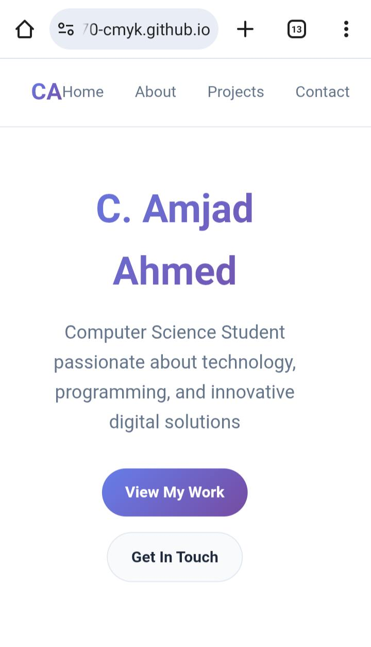
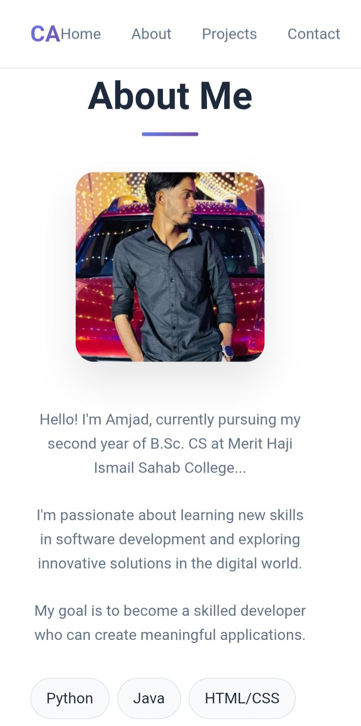
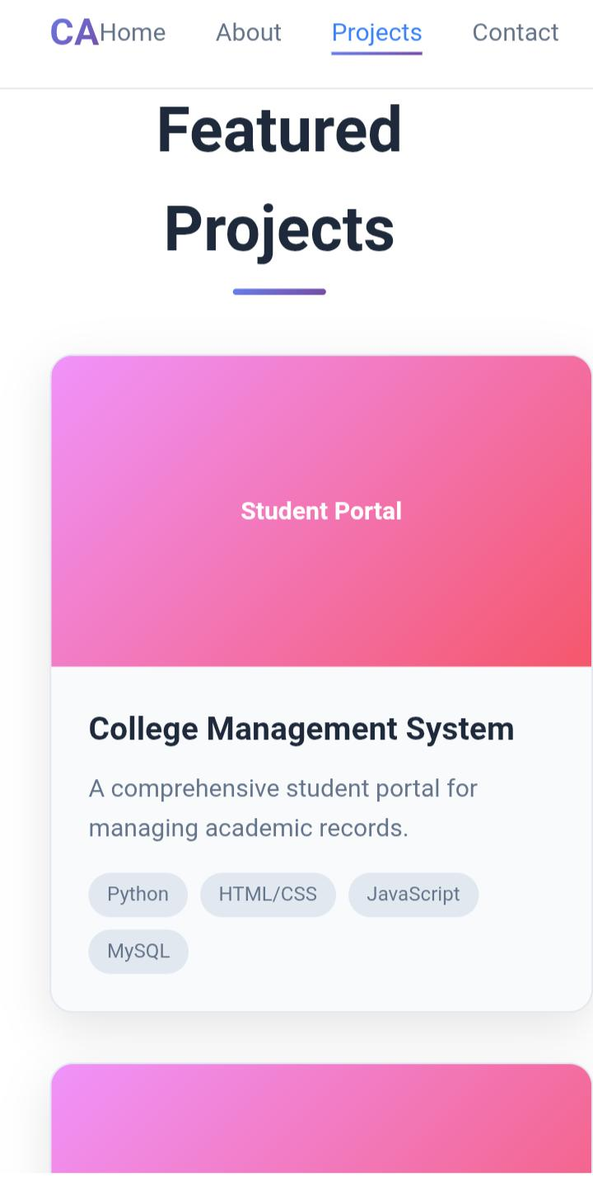
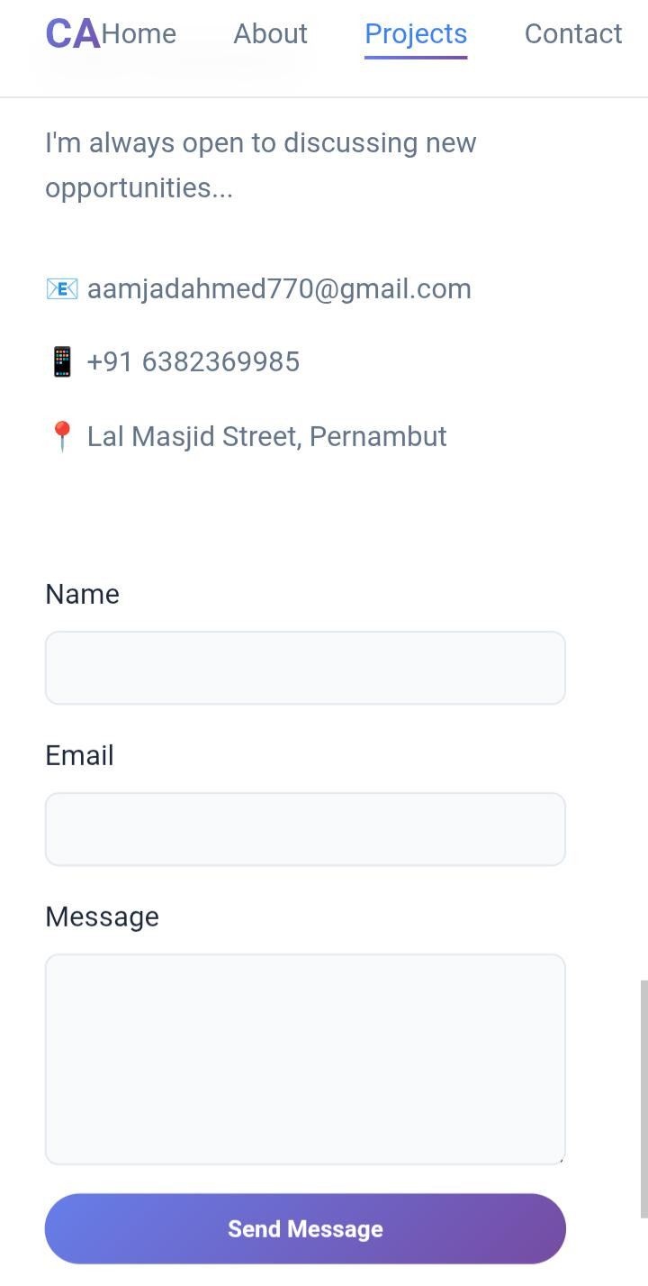

RESULTS AND SCREENSHOTS
3/21/2024 Annual Review
10

Slide 11
CONCLUSION
The Personal Portfolio Website of C. Amjad Ahmed was successfully designed and developed to serve as a digital resume and professional identity platform. The website highlights academic qualifications, technical skills, and project work in a visually appealing and interactive manner.By incorporating responsive design, light/dark themes, and smooth user interactions, the portfolio ensures accessibility and usability across devices. It also provides an easy way for recruiters, faculty, and collaborators to connect through the integrated contact form and social media links.
11

